Slide 1
Introduction to NAMD
SHUG-2015
Jose M. Borreguero
Neutron Data Analysis and Visualization Division
Center for Accelerating Materials Modelling

Slide 2
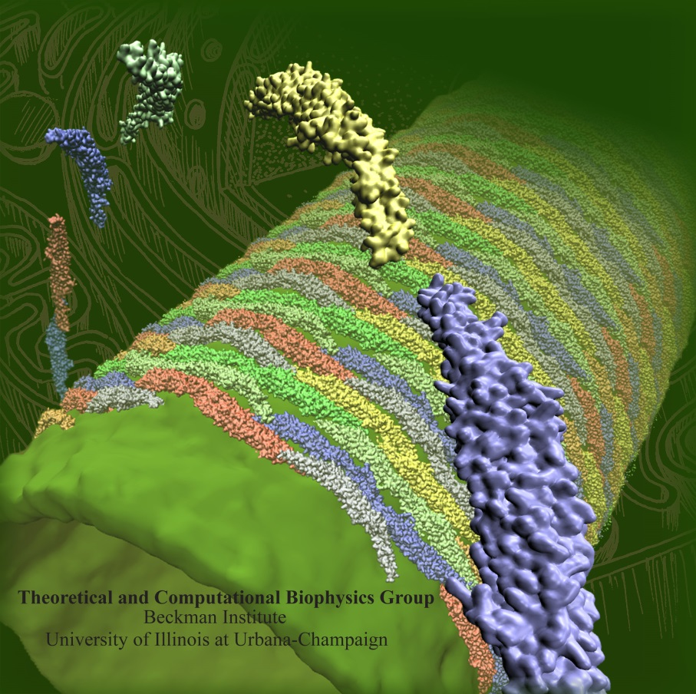
Not (just) Another Molecular Dynamics
http://www.ks.uiuc.edu/Research/namd
Free to use and easy to install
Accepts various popular force fields
AMBER, CHARMM, X-PLOR
Highly efficient when running in parallel
Multiple environments available
different thermodynamic ensembles
external fields defined by user
Complex dynamic schemes
restraints
replicas
free energy calculations

Slide 3

Requirements to run a NAMD simulation

Slide 4
Input files

